Slide 1

Recipianza
The Cyber Vikings

Slide 2
About: Recipanza
Recipanza is a react native application. Individuals who want to learn about recipes and try them out on their own get a variety of recipes using this application. They can read all the recipes in application and mark any recipe as their favorite. Users can also share recipes on different platforms.
Technology Used: React-Native
Database - Firebase
Version control - GitHub
Harshit Modi

Slide 3
Role : Team Leader
Implemented Signup, Home and Profile screen.
Coordinated with team and allocated them work.
Implemented Firebase Api call for Signup with Email and password.
Get Recipe list and User profile data.
Managed GitHub Repository.
Harshit Modi

Slide 4
Role : Team Member
Initial react native project structure.
Implemented Login & Recipe detail screens.
Coordinated with team for screen designs based on wireframes.
Setup firebase.
Implemented Constants, Firebase config & User Utils.
Implemented Stack navigation & bottom tab navigation.
Implemented Sign In with email & password with firebase.
Implemented share functionality of recipe.
Use Async storage for checking user is currently logged in or not.
Daksh Upadhyay

Slide 5
Role : Team Member
Responsible for App Design
User Experience
Logo Design
Implementation of Splash Screen.
Daljit Singh

Slide 6


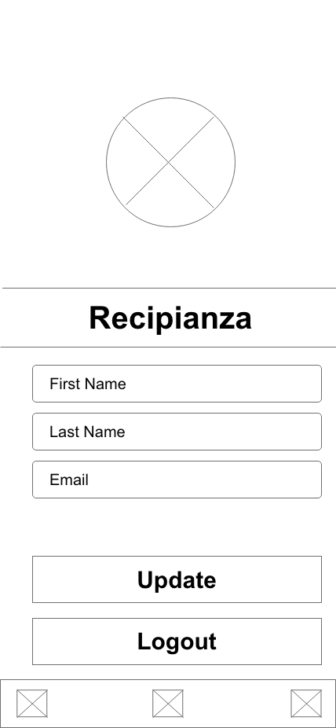
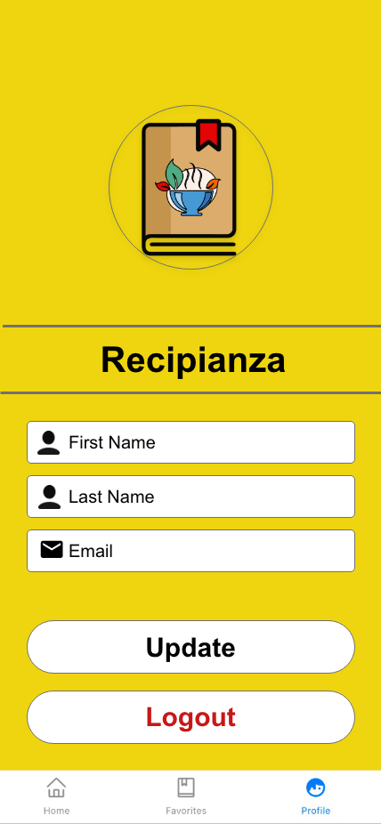

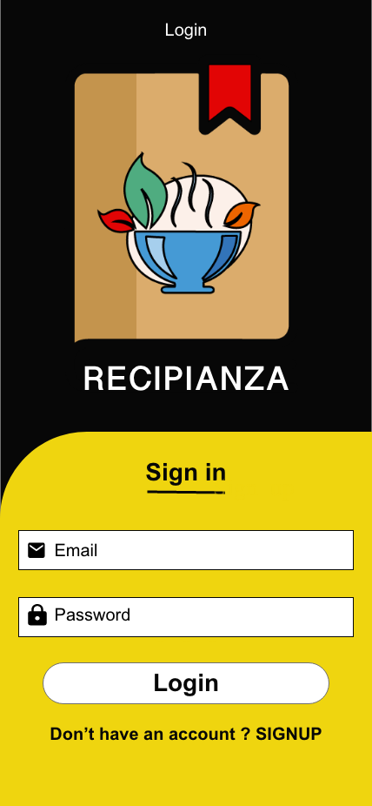
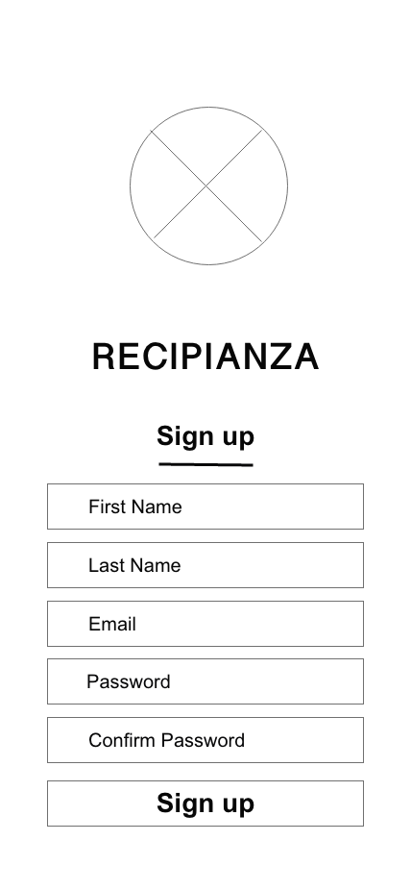
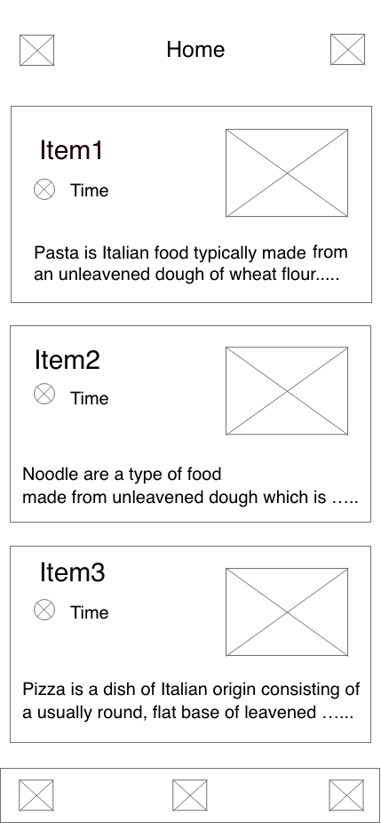
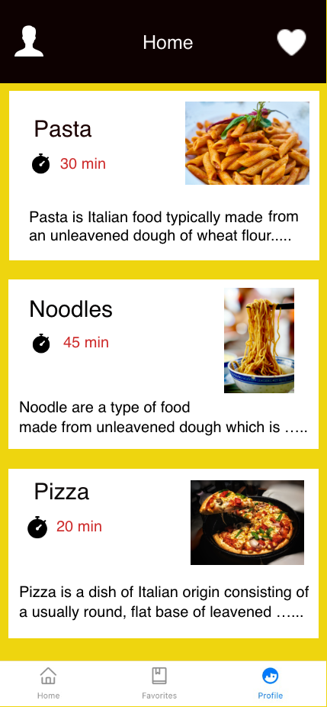
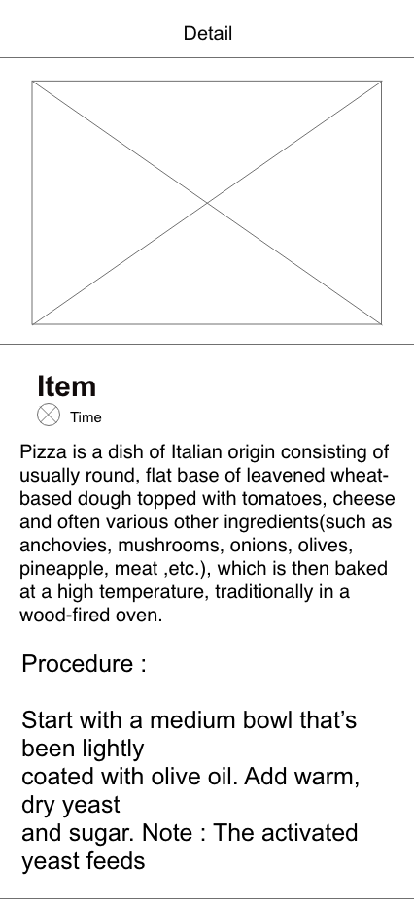
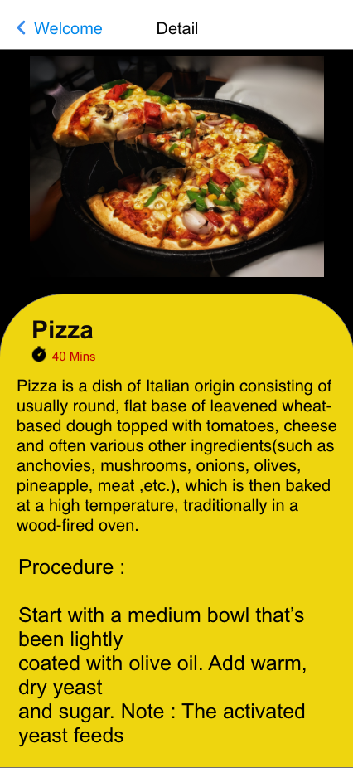
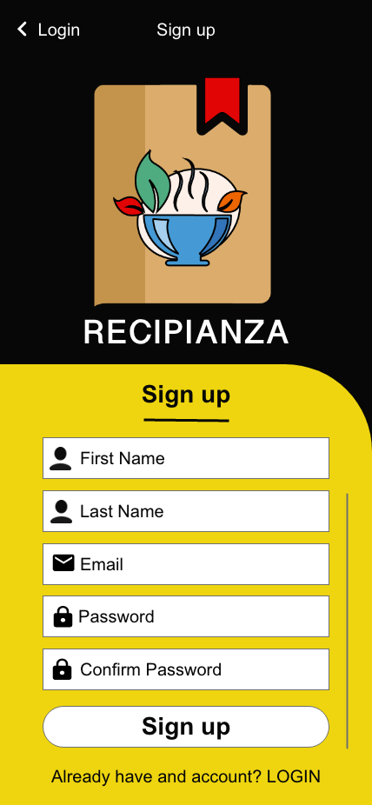
Daljit Singh

Slide 7
Role : Team Member
Developed Login credentials and validation in the project
Designed screens for Login
Merged all screens.
Implemented Validation on all Text Fields.
Collaborated in coding and checking for validation errors.
Akshay Kondapalli

Slide 8
Role : Team Member
Contributed to creating and preparing "STRUCTURE" layer final documentation.
Designed screens like Home and Recipe details.
Merged all adobe designs of other members and created one single file.
Implementation of home and detail screen.
Sanket Patel

Slide 9
Role : Team Member
Implemented favorite screen as Home screen.
Contributed to creating and preparing “STRUCTURE” layer final documentation.
Prepare presentation.
Proofread of document.
Zalak Vanodiya

